Slide 1
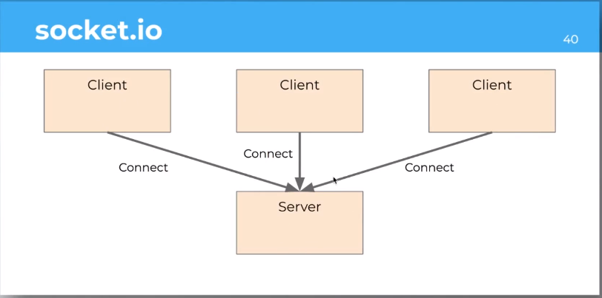
server.js
1. สร้าง folder งาน
2.เข้าไปใน Foleder แล้ว npm init
3.npm install socket.io

Slide 2
1. สร้าง folder งาน
2.เข้าไปใน Foleder แล้ว npm init
3.npm install socket.io
4.เข้าไป โปรเจค React เก่าเพื่อใช้เป็น Client ของ Chat
5.Install Client #npm install socket.io-client
A : Project ChatRoom
Library
react
react-router-dom
Socket.io-client
B : Project Chat Server
Library
Socket.io

Slide 3
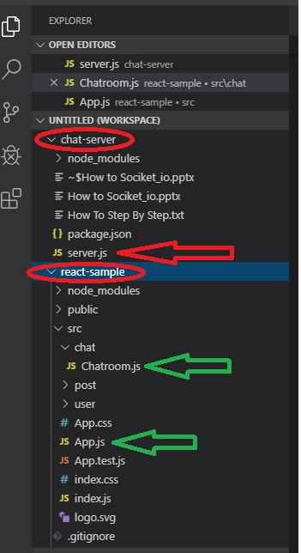
3 Files
App.js ทำหน้าที่ route ระหว่าง Server กับ Chatroom (อยู่ใน Project หลัก)
Chatroom.js (อยู่ใน Project หลัก)
server.js (แยกออกไปอยู่ใน Project Chat-Server)
#App.js
import React, { Component } from 'react';
import logo from './logo.svg';
import './App.css';
import User from './user/User'
import Post from './post/Post'
import { Route } from "react-router-dom"
import {Link} from 'react-router-dom';
import Chatroom from './chat/Chatroom';
class App extends Component {
state = {
name : "FuturSkill"
}
onNameChange = name => {
this.setState({name : name});
}
render() {
const {name} = this.state;
return (
<div>
Hello { name } <br/>
<Link to='./'>Home</Link> &nbsp;
<Link to='./users'>Users</Link> &nbsp;
<Link to='./posts'>Post</Link> &nbsp;
<Link to='./chat'>Chat</Link>
<Route path='/users' component={User}></Route>
<Route path='/posts' component={Post}></Route>
<Route path="/chat" component={Chatroom} />
</div>
);
}
}
export default App;

Slide 4
#Chatroom.js
import React, { Component } from 'react';
import socketIOClient from 'socket.io-client'
class Chatroom extends Component {
state = {
socket: null,
count: 0
}
componentDidMount(){
const socket = socketIOClient('localhost:8080')
this.setState({socket:socket});
// socket.emit("emit", {data:"test"});
socket.on("count", data => this.handleCount(data));
}
handleCount = data => {
this.setState({ count:data.count});
}
onClick = () => {
let { socket, count } = this.state;
count = count + 1;
this.setState({ count: count});
socket.emit("emit", {count: count });
}
render() {
return (
<div>
<div>{this.state.count}</div>
<button onClick={this.onClick}>Count</button>
</div>
);
}
}
export default Chatroom;

Slide 5
#server.js
const server = require("http").createServer();
const io = require("socket.io")(server);
io.on("connection", function(socket){
socket.on("emit", function(Data){
// console.log("Receive Data");
console.log(Data);
socket.broadcast.emit("count", {count:Data.count});
});
});
server.listen(8080, function(err) {
if (err) throw err;
console.log("Server is listening to port 8080")
});

Slide 6
#server.js
const server = require("http").createServer();
const io = require("socket.io")(server);
io.on("connection", function(socket){
socket.on("emit", function(Data){
// console.log("Receive Data");
console.log(Data);
socket.broadcast.emit("count", {count:Data.count});
});
});
server.listen(8080, function(err) {
if (err) throw err;
console.log("Server is listening to port 8080")
});

